Slide 1

Educational & Health Support System in Rural Areas
Presented By,
Archana S
Renju R S
Shivanya P M
Sreekutty S Vinod
V Meenakshy

Slide 2
Content
Introduction
Outline of the project
Technology Stack and architecture
Machine Learning -Dataset and Algorithms
User Flow
Future Scope
Conclusion

Slide 3

Introduction
Motto: Unearth and Serve
Locate people and provide financial support for health and education
.

Slide 4
Outline of the Project
Identify the rural areas
Collect the details of needy persons
Develop a web application
Invite sponsors to support

Slide 5






Technology Stack and Architecture
User
axios calls
Request
Presentation Layer
Business Logic Layer
Database Layer
React
Bootstrap
Material Ui
JSON Response
Response

Slide 6
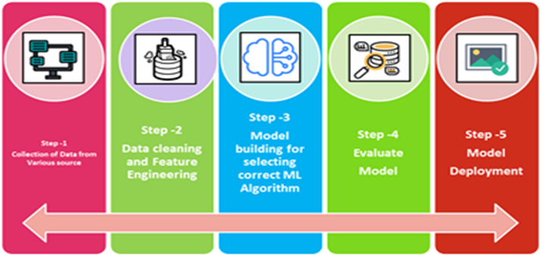
Machine Learning Process

Slide 7
ML Process - Dataset Description
Education dataset:
1.Aadhar ID (Numeric)
2.Ration card Category(Nominal; BPL{0}& APL{1})
3.Monthly Income of Family(Numeric)
4.Gender(Nominal; Female{0}& Male{1})
5.Age(Numeric)
6.Number of Employed persons in Family(Numeric)
7.Currently Studying(Nomina;Yes{1},No{0})
8.Education Level(Nominal ;LP{0},HS{1},S{2},G{3})
9. Interested to Continue(Nominal;Yes-1,No-1)
10. Qualified(Nominal;Yes-1,No-0)
11.Target (Nominal;Eligible-1,Not Eligible-0)
Health Dataset:
1.Aadhar ID (Numeric)
2.Ration card Category(Nominal; BPL-0 & APL-1)
3.Monthly Income of Family(Numeric)
4.Gender(Nominal; Female-0 & Male-1)
5.Chronic Disease or not (Nominal; Yes-1,No-0)
6.Critical or not (Nominal;Yes-1,No-0)
7.Surgery needed or not (Nominal;Yes-1,No-0)
8.Target (Nominal;Eligible-1,Not Eligible-0)

Slide 8
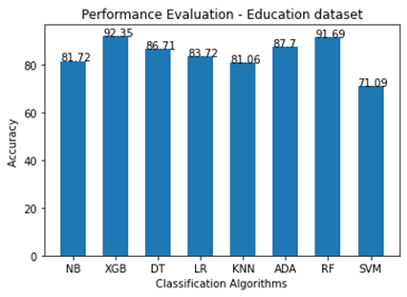
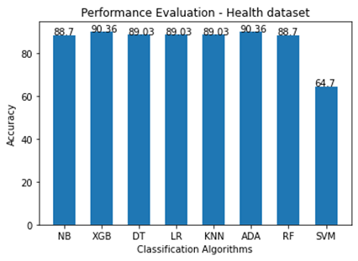
ML Performance Evaluation and Deployment

Slide 9
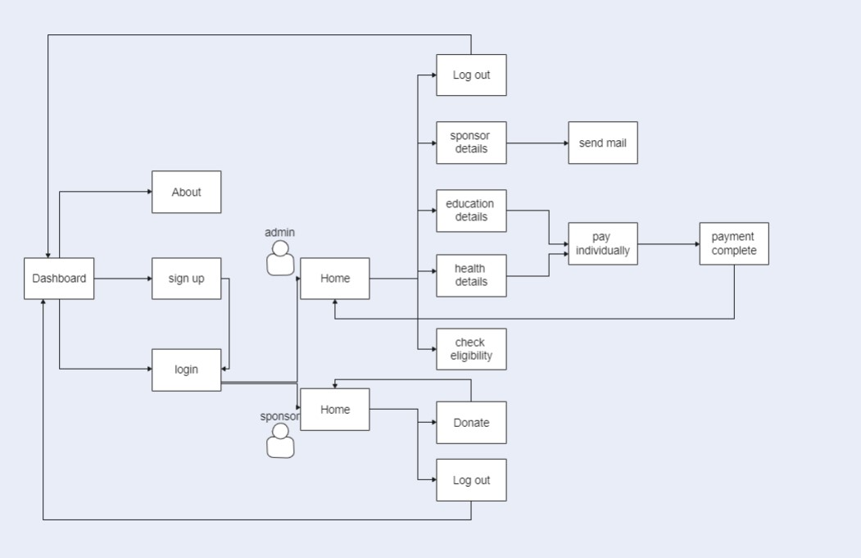
User Flow Diagram

Slide 10
Future Scope
Implement crowd funding
Sending notifications to sponsors
Project can be extended to other states as well.
Direct Payment to the needy.

Slide 11
Conclusion
Unearth and Serve is therefore meant to be done for public benefit,especially for those who are from rural areas
This technology is a relief and to provide assistance to people at the time of their needs.
Also a good platform for the people who wish to help others.

Slide 12
Github repository
https://github.com/Shivanyapm/HelpingHands

Slide 13
THANK YOU!
Any Queries?

